Slide 1
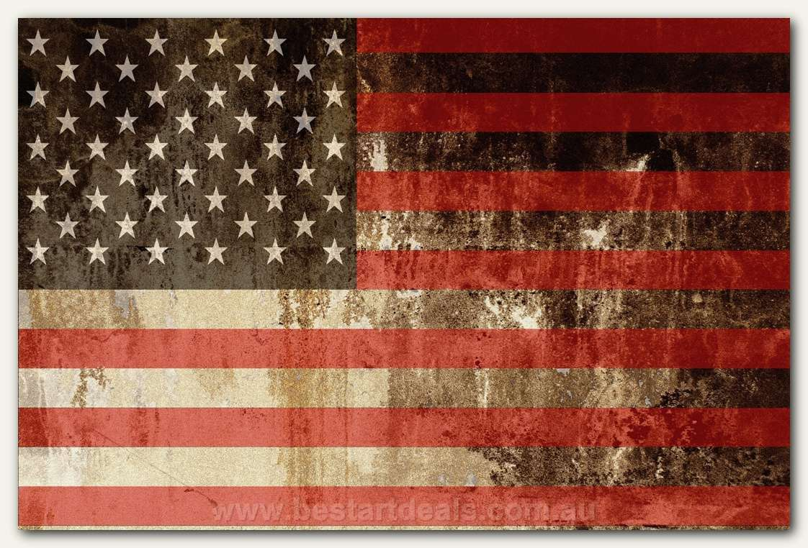
American Revolution
Luke, Paris, Amanda & Stephanie

Slide 2
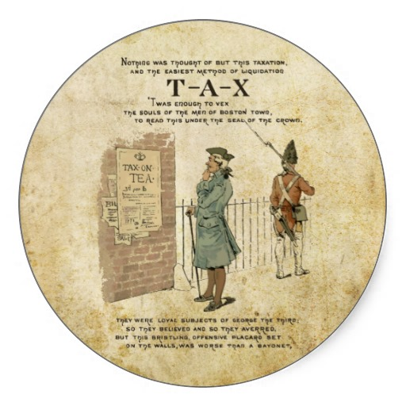
Political Causes
The Stamp Act- Taxed all printed paper
Townshend Act- Taxed tea, glass, etc.
“No taxation without representation.”
Boston Tea Party- Granted British E.I.T.C. monopoly of tea trade in America

Slide 3
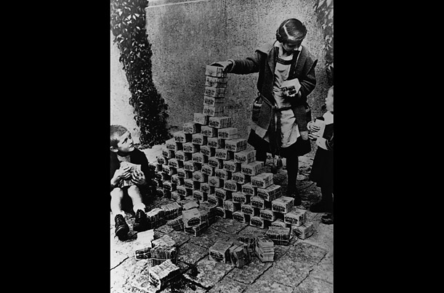
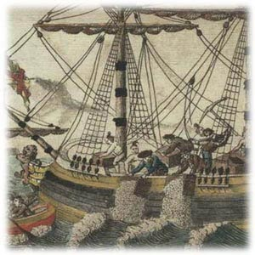
Economic Causes
Colonies weren’t able to print their own money
They were being unfairly treated

Slide 4
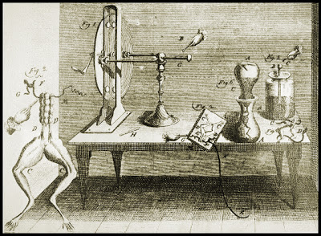
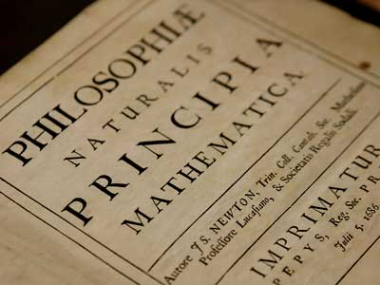
Social Causes
Age of Enlightenment played a role
They were sick of a king telling them how to live
Racism within the Indian tribes, they wanted the land for themselves

Slide 5
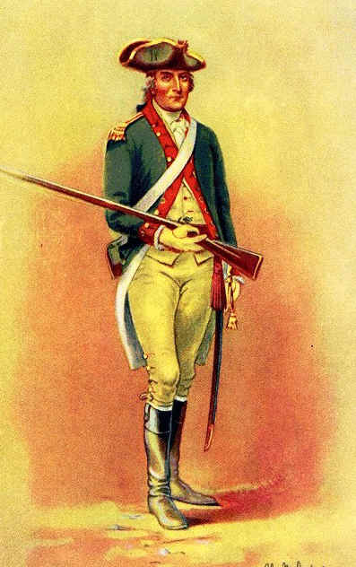
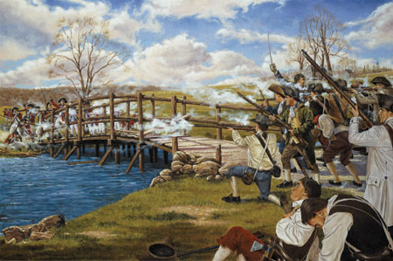
Patriots
People who defeated the British
People who didn’t want to be a part of Great Britain

Slide 6
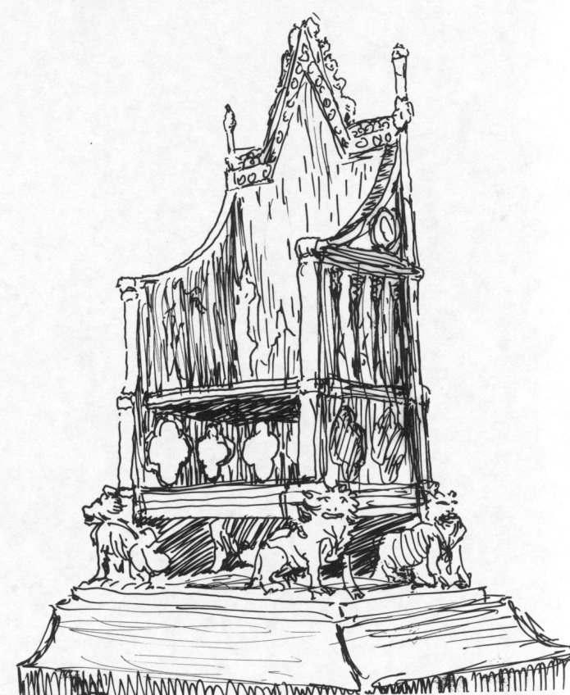
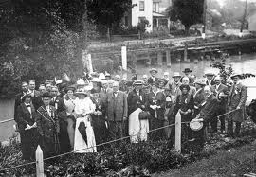
Loyalists
American colonists who remained loyal to the kingdom of great Britain

Slide 7
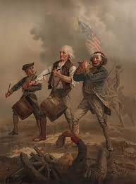
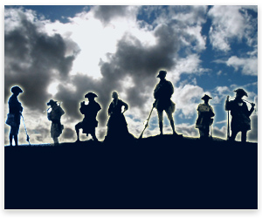
Sons of liberty
Group of American patriots that worked the pre-independence; north American British colonies. They wanted to side with the patriots.

Slide 8
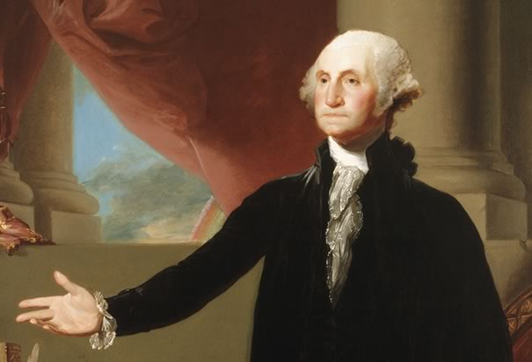
Important Leaders
Washington
First President of the united states.
Commander & Chief.
“I hope I shall possess firmness
and virtue enough to maintain
what I consider the most enviable
of all titles, the character of an honest man.”
“Be courteous to all,
but intimate with few,
and let those few be well
tried before you give them
your confidence.”

Slide 9
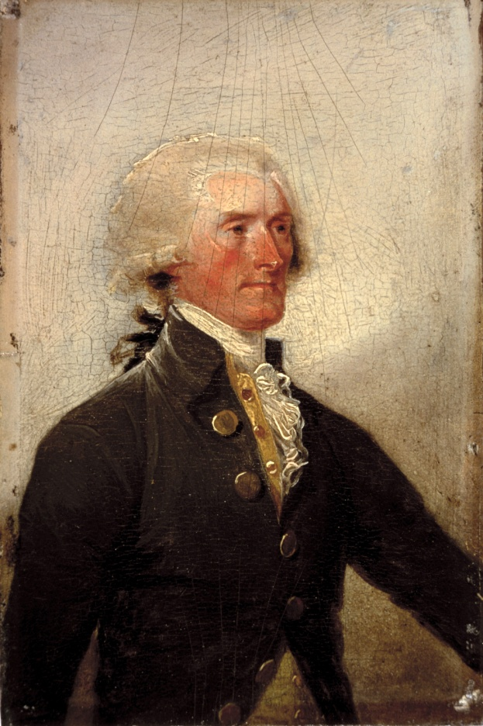
Jefferson
Author of the Declaration of Independence.
Third President of the United States.
The beauty of the 2nd Amendment
is that it will not be needed
until they try to take it.
“The strongest reason for the people to retain the right to keep and bear arms is, as a last resort, to protect themselves against tyranny in government.”

Slide 10
King George III
King of Great Britain.
Revolutionary War. (U.S. won there independence.)

Slide 11
Madison
Father of the Constitution.
Helped write the Bill of Rights.
4th U.S. President.

Slide 12
Important Events
1775- Patrick Henery “Give me liberty or give me Death.” Geroge Washington Commander and Chief.
Bunker Hill

Slide 13
July 4th, 1774
Independence Day.
War won Declaration of Independence.

Slide 14
1781
British and America, (November 30th)signed Preliminary Articles of Peace.
British left the Charleston, SC

Slide 15
1783
Sept. 3rd, US & GB signed Treaty of Paris.
British troops leave New York City.

Slide 16
1789
1st U.S. Presidential Election.
Constitution goes into effect.
G.W. Inaugurated as President in New York City.

